Slide 1
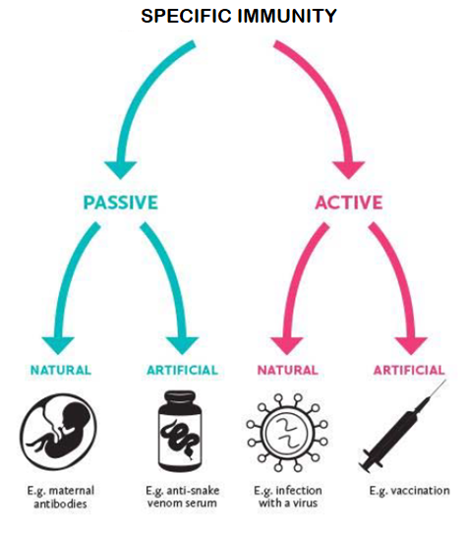
Types of Specific Immunity

Slide 2
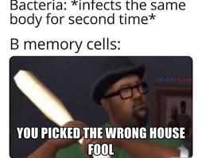
Date: | Human Biology Year 12 ATAR
Do Now Get out your stuff, ready to start! Lesson Agenda 1: Do Now 2: Types of Specific Immunity 3: Review Worksheet Suggested Study Complete review worksheet, mark and correct using answer key on Connect. Read through today’s notes and textbook section NEXT LESSON Past Exam Question Antibiotics and Antivirals | Learning Aims Explain the differences between active and passive immunity Explain the differences between natural and artificial immunity Describe how each of the following may occur, with an example. Active Natural Immunity Active Artificial Immunity Passive Natural Immunity Passive Artificial Immunity
 | Key Vocabulary Antigen Antibody Active Passive Artificial Natural

Slide 3
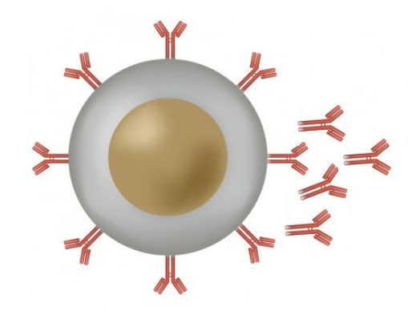



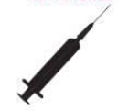

Active vs Passive Immunity
ACTIVE
Exposure to antigen causes body to actively produce immunity
sensitisation of lymphocytes, producing cell mediated and antibody mediated immunity.
memory cells.
Eg: When a virus naturally enters your body, your body actively fights it off via the process above.
Eg: When you get a vaccine, your body actively produces antibody via the process above
PASSIVE
Body gets “ready made” antibody from another source – body does not need to actively work to produce the antibody. Body is not exposed to the antigen, so active immunity can’t develop.
Antibody received neutralises any pathogens present but will be used up.
No memory cells produced
Eg: Antibody produced by the mother passes through the placenta and breast milk to the baby
Eg: Snake antivenom is bottled antibody that is injected into the blood to neutralise venom
Learning Aim: Explain the differences between active and passive immunity

Slide 4


Natural vs Artificial Immunity
NATURAL
Immunity develops via natural processes in the human body.
Eg: When a virus naturally enters your body, your body actively fights it off via cell-mediated and anti-body mediated immunity.
Eg: Antibody naturally produced by the body are passed from mother to baby via the placenta and breast milk so that the baby becomes temporarily, passively immune.
ARTIFICIAL
Scientific processes are used to create immunity.
Eg: vaccines are developed to produce active immunity without illness.
Eg: Snake antivenom is produced so that antibodies to the venom can be injected into a person bitten by a snake to neutralise the venom.
Learning Aim: Explain the differences between natural and artificial immunity

Slide 5
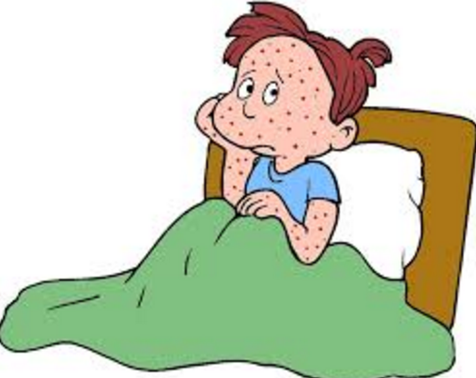
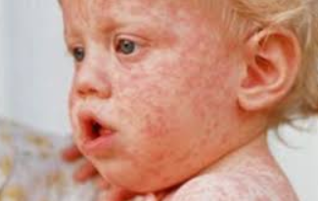
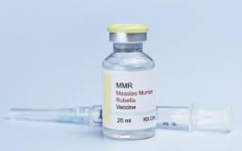
Example: Active Natural Immunity
Eg: Getting the Measles
Measles is a virus that occurs naturally.
If someone is exposed to the Measles virus, their immune system responds actively.
B-cells and T-cells (lymphocytes) become sensitised
produce antibody to fight the virus via Antibody Mediated (Humoral) Immunity
Produce memory cells specific to the virus so next encounter will be neutralised before symptoms develop
Learning Aim: Explain how active natural immunity occurs, with an example

Slide 6
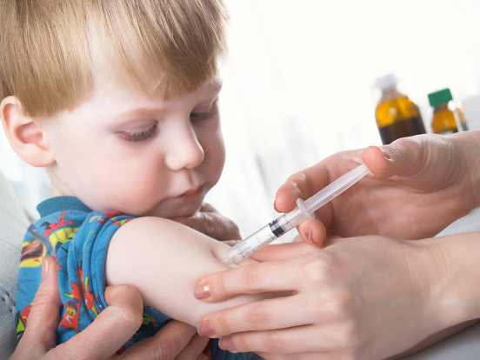
Example: Active Artificial Immunity
EG: Receiving a Measles Vaccine
The measles vaccine is artificial – it is man-made
A vaccine is given, containing either killed measles virus, substances that mimic the measles antigen, or a very mild form of the virus. The body then responds actively to produce long lasting immunity.
B-cells become sensitised
Antibody produced via antibody-mediated immunity
Memory cells produced
Immunity to measles results.
Learning Aim: Explain how active artificial immunity occurs, with an example

Slide 7
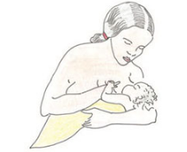
Example: Passive Natural Immunity
EG: child gets antibodies via breastfeeding or across placenta
The antibodies are made naturally by the mother’s immune system.
Baby gets antibodies from breastmilk or across placenta. The baby gets the antibody without the baby’s immune system having to do anything. The process is passive.
Baby then has circulating antibody to neutralise specific pathogen.
Doesn’t last – no active response from baby’s immune system, no memory-cells produced.
Learning Aim: Explain how passive natural immunity occurs, with an example

Slide 8
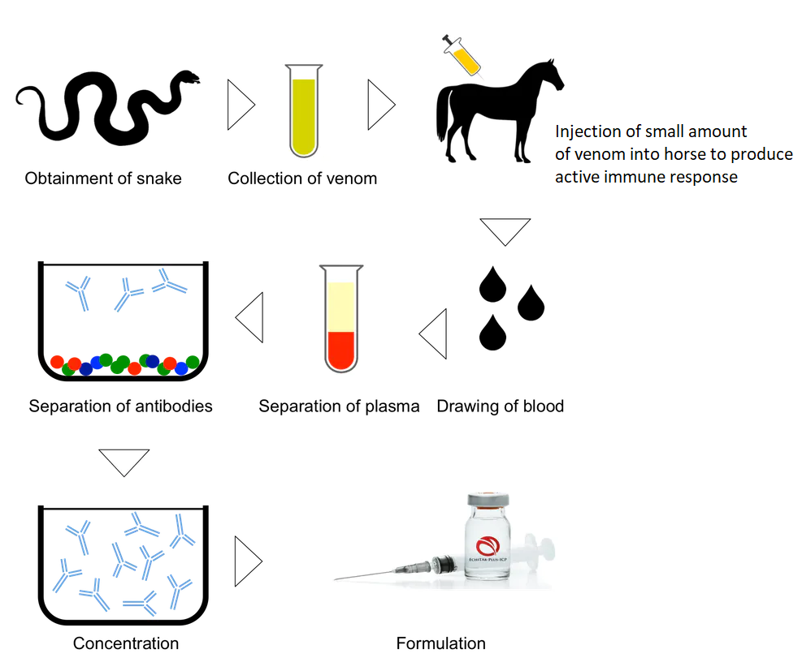
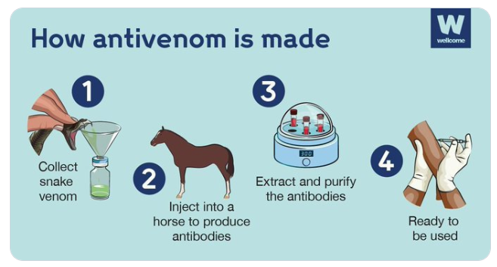

Example: Passive Artificial Immunity
Eg: administration of snakebite antivenom
Antibodies to snake venom produced via a man-made process (artificial)
Antibody injected into patient’s bloodstream:
Antibody neutralises venom
Body does not work to develop immunity – gets antibody passively
Short term only – no memory-cells produced
Learning Aim: Explain how passive artificial immunity occurs, with an example

Slide 9
Summary Table: Types of Immunity
 | Active Immunity Body actively produces antibody Antibody mediated process Memory cells produced Long term immunity – more antibody can be produced each time pathogen is encountered. | Passive Immunity Antibodies are gained from another source Body gains antibody passively – immune system not involved. No memory cells produced Immunity only lasts until antibody used up.
Natural | Catching tetanus Tetanus toxin enters body, B-cells activated, antibody produced actively. Immune system will recognise toxin next time it is encountered. | Getting tetanus antibodies from mothers’ milk Antibodies will neutralise toxin if present but immune system isn’t activated, so no future immunity.
Artificial | Getting the tetanus Vaccine Tetanus toxoid vaccine enters body, B-cells activated, antibody produced actively. Immune system will recognise toxin next time it is encountered. | Getting man-made tetanus antitoxin injected Antibodies in antitoxin will neutralise toxin if present but immune system isn’t activated, so no future immunity.

